Slide 1

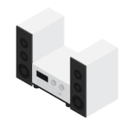

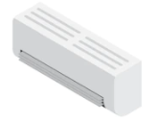
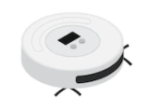

Smart Remote Control
Final Presentaion
Team 12

Slide 2
CONTENTS
PART 1
PART 2
PART 3
PART 4
PART 5
1. Overview
2. UI
3. Front-end
4. Back-end
5. Database

Slide 3
1
Problem
PART 1
Overview
2
Goal

Slide 4

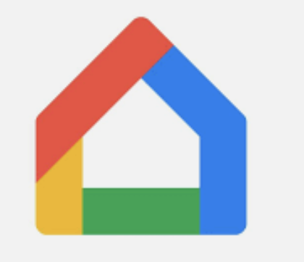
01
Overview
Problem
Apple homes and google home are two major smart home applications in the market.

Slide 5
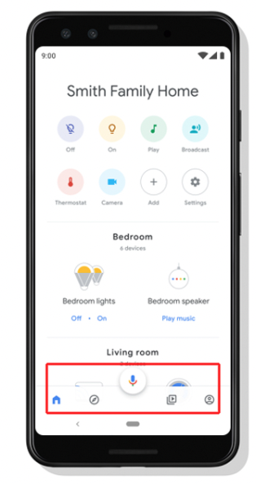
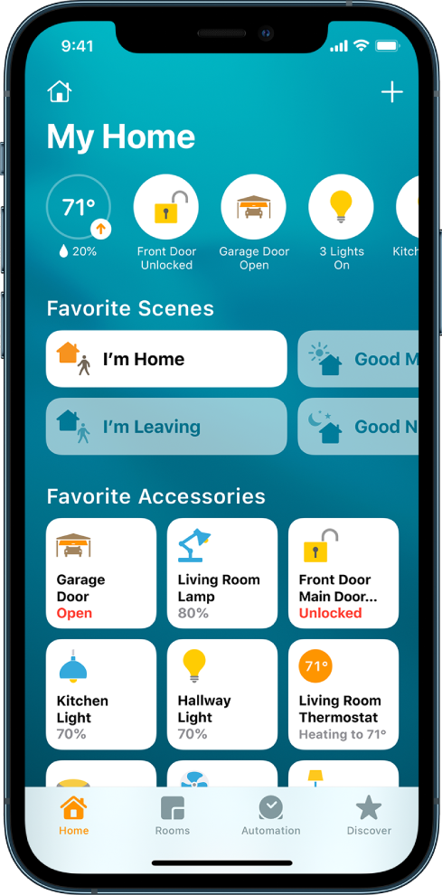
01
Overview
Problem
Apple homes and google home are two major smart home applications in the market.

Slide 6
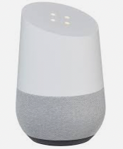
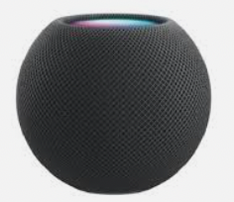
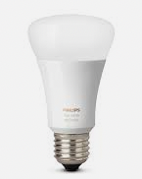
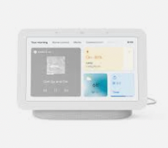
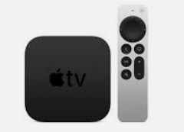
01
Overview
Problem
There are various devices that each apps support. But there are not much devices that is supported by both apps

Slide 7


👵🏻 🧓🏻 👦🏻 👩🏻
01
Overview
Problem
Family who have mixed use of Android phones and iPhones get limited choices.

Slide 8
01
Overview
Problem
There are various devices that each apps support. But there are not much devices that is supported by both apps

Slide 9
👵🏻 🧓🏻 👦🏻 👩🏻
01
Overview
Problem
Family who have mixed use of Android phones and iPhones get limited choices.

Slide 10
01
Overview
Problem
Smart home appliances market share is still very low. Most of the households use regular home appliances.

Slide 11
👵🏻 🧓🏻 👦🏻 👩🏻
01
Overview
Goal
Using non-Smart home appliances
Using both Android/iPhone
+
Our product target families who 1) use regular home appliances and
2) have both Android and iPhones

Slide 12
1
User
PART 2
UI
2
Appliance
3
Control

Slide 13
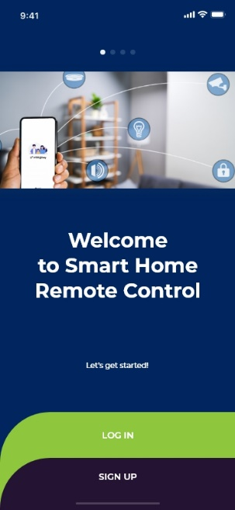
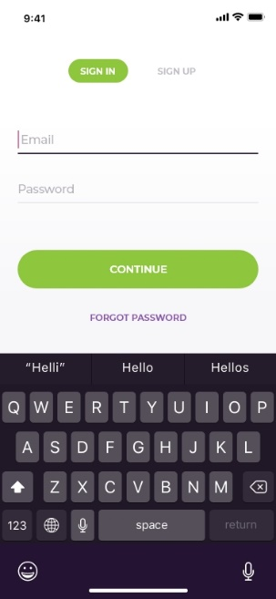
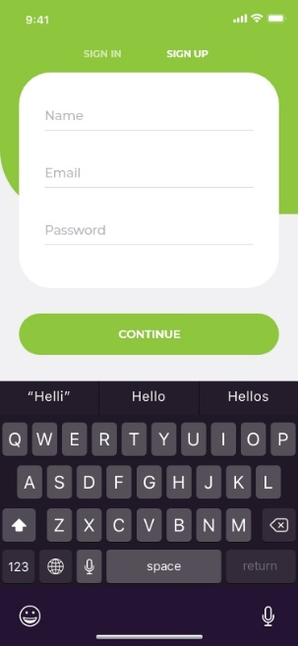
02
UI
User

Slide 14
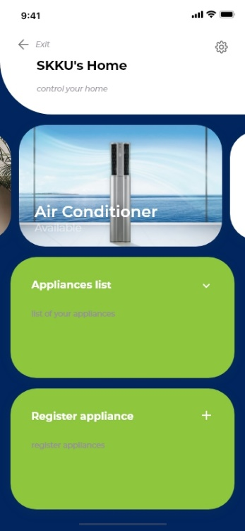
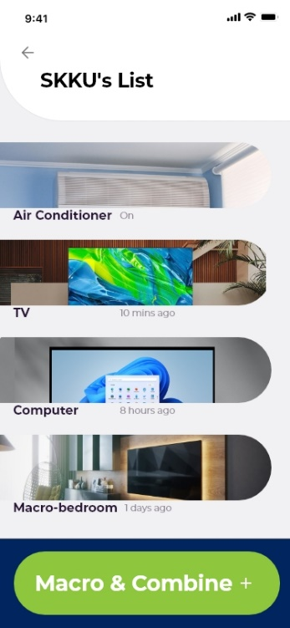
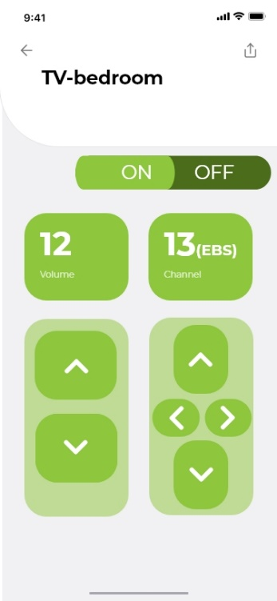
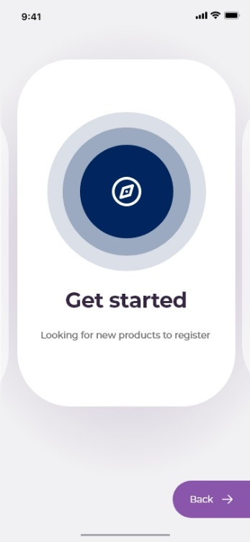
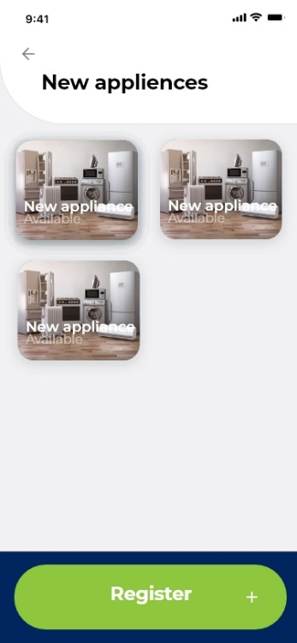
02
UI
Appliance

Slide 15
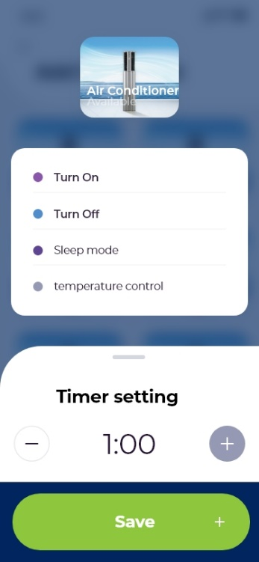
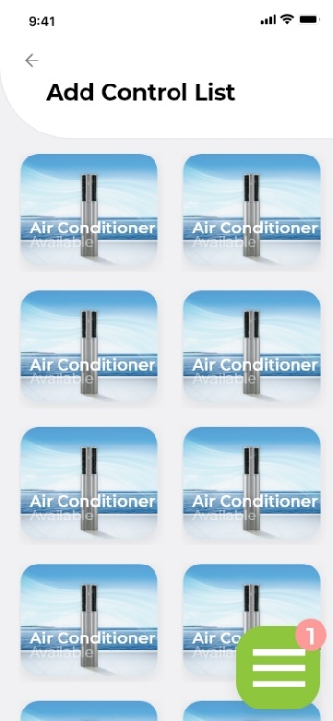
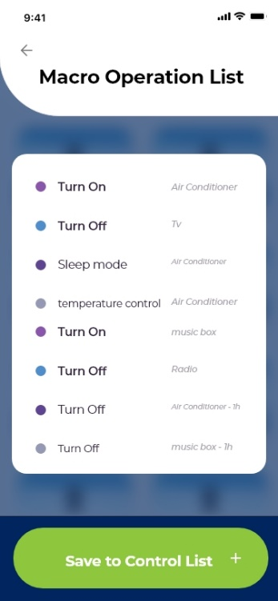
02
UI
Control

Slide 16
1
User
PART 3
Front-end
2
Appliance
3
Control

Slide 17
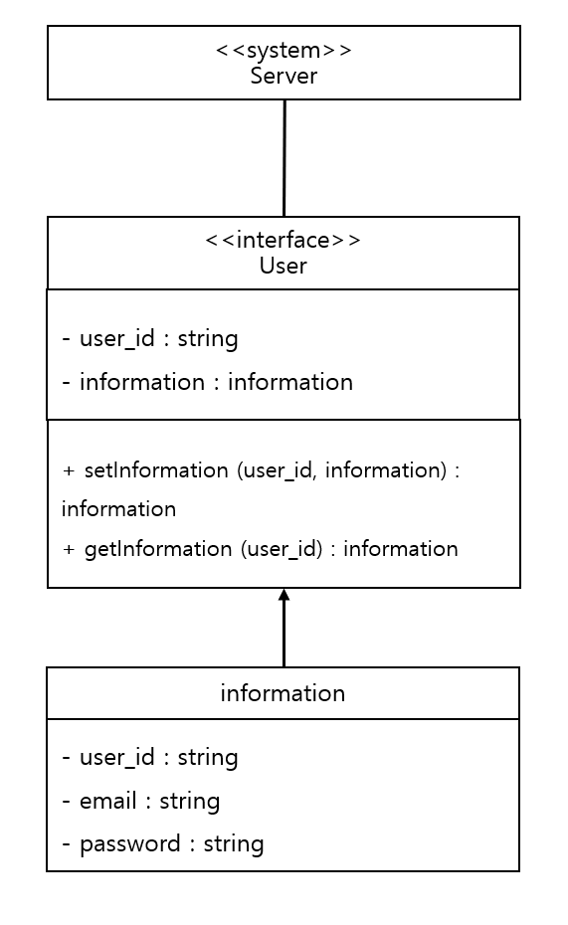
02
Front-end
User – Class Diagram

Slide 18
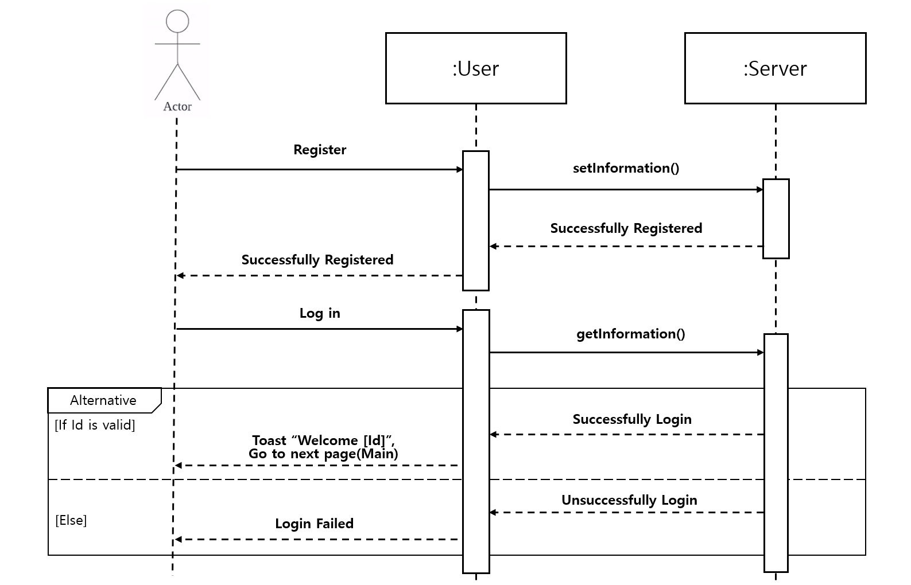
02
Front-end
User – Sequence Diagram

Slide 19
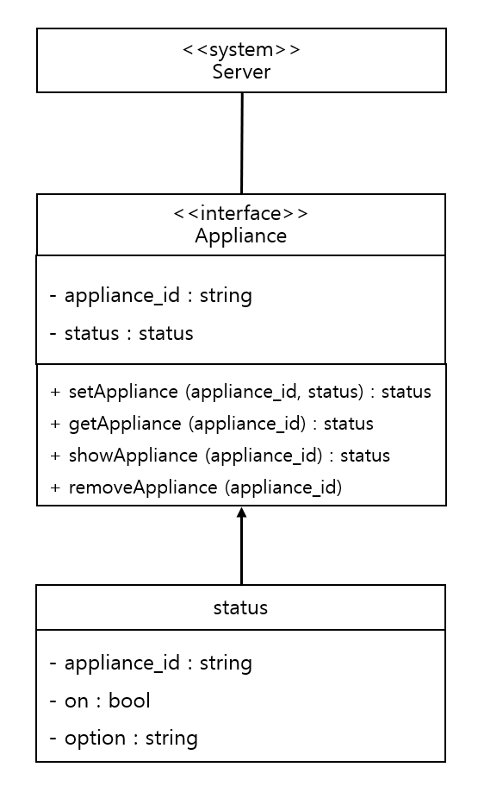
02
Front-end
Appliance – Class Diagram

Slide 20
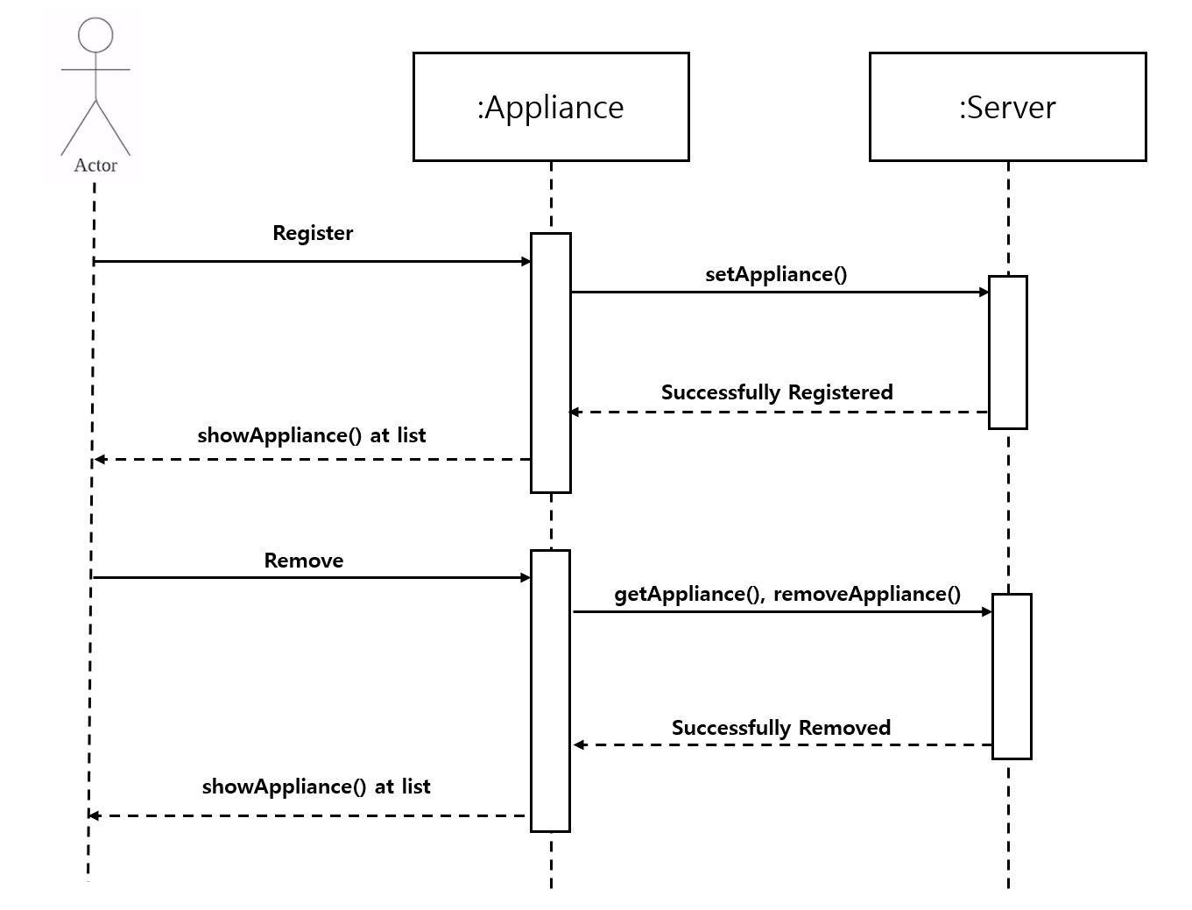
02
Front-end
Appliance – Sequence Diagram

Slide 21
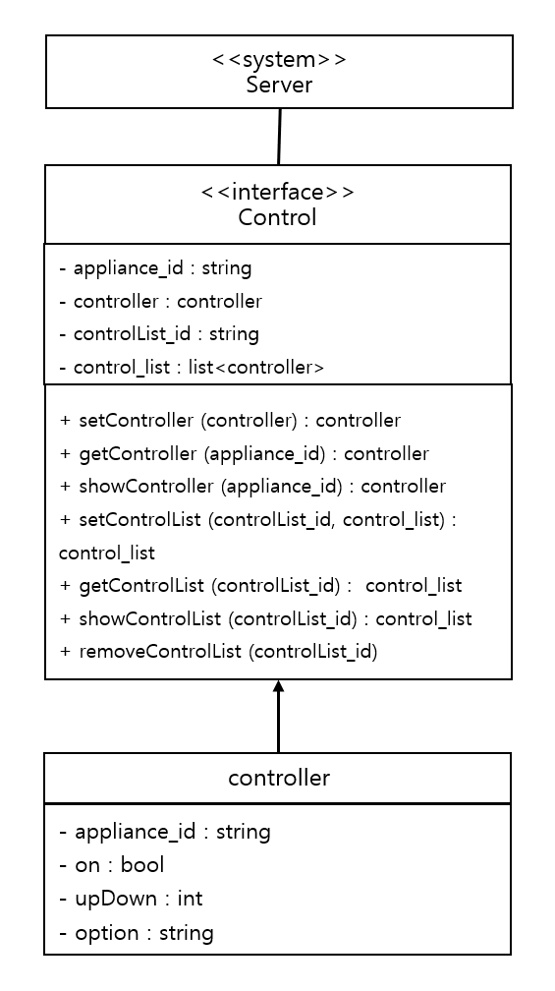
02
Front-end
Control – Class Diagram

Slide 22
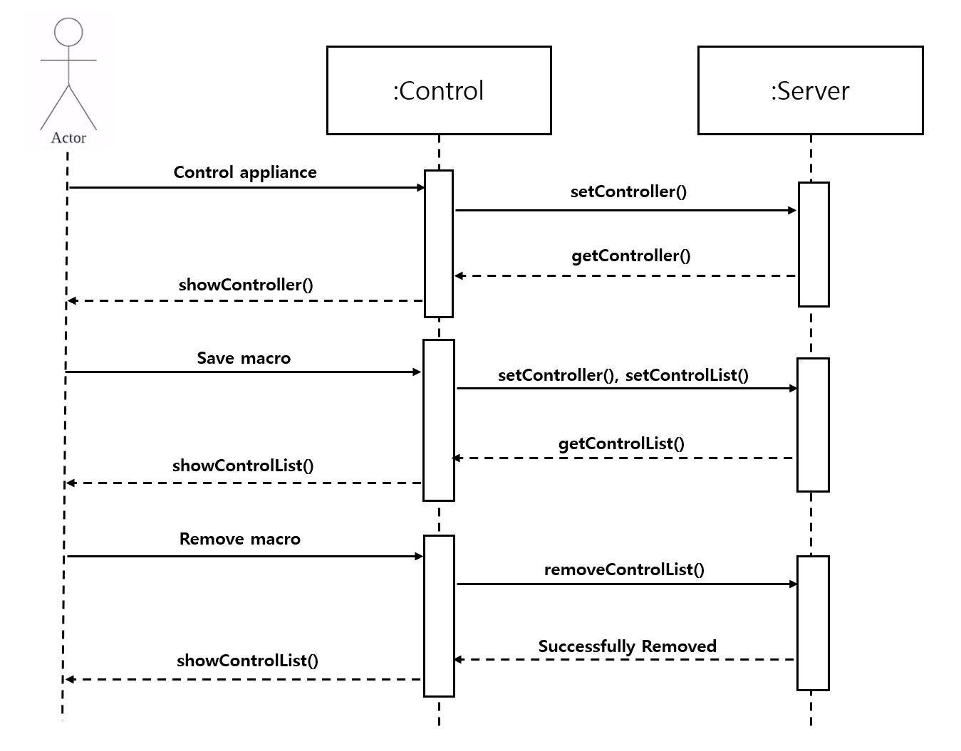
02
Front-end
Control – Sequence Diagram

Slide 23
1
Wired appliances control
PART 4
Back-end
2
Wireless smart appliances control
3
Wireless non-smart appliances
control

Slide 24
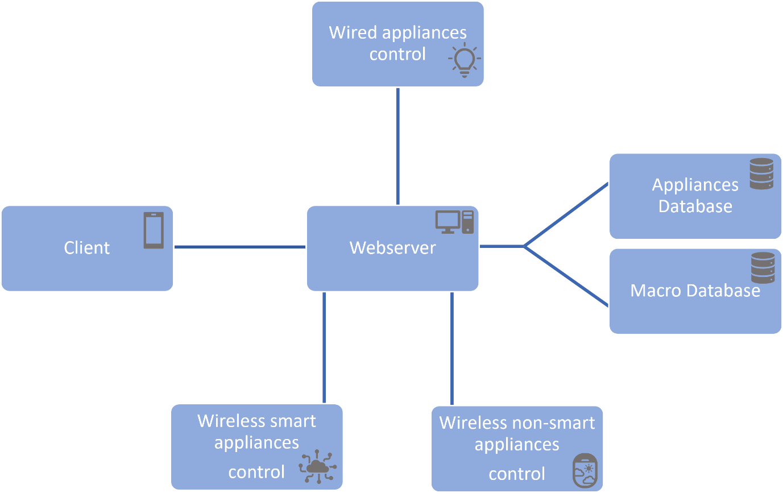
03
Back-end
Overview

Slide 25
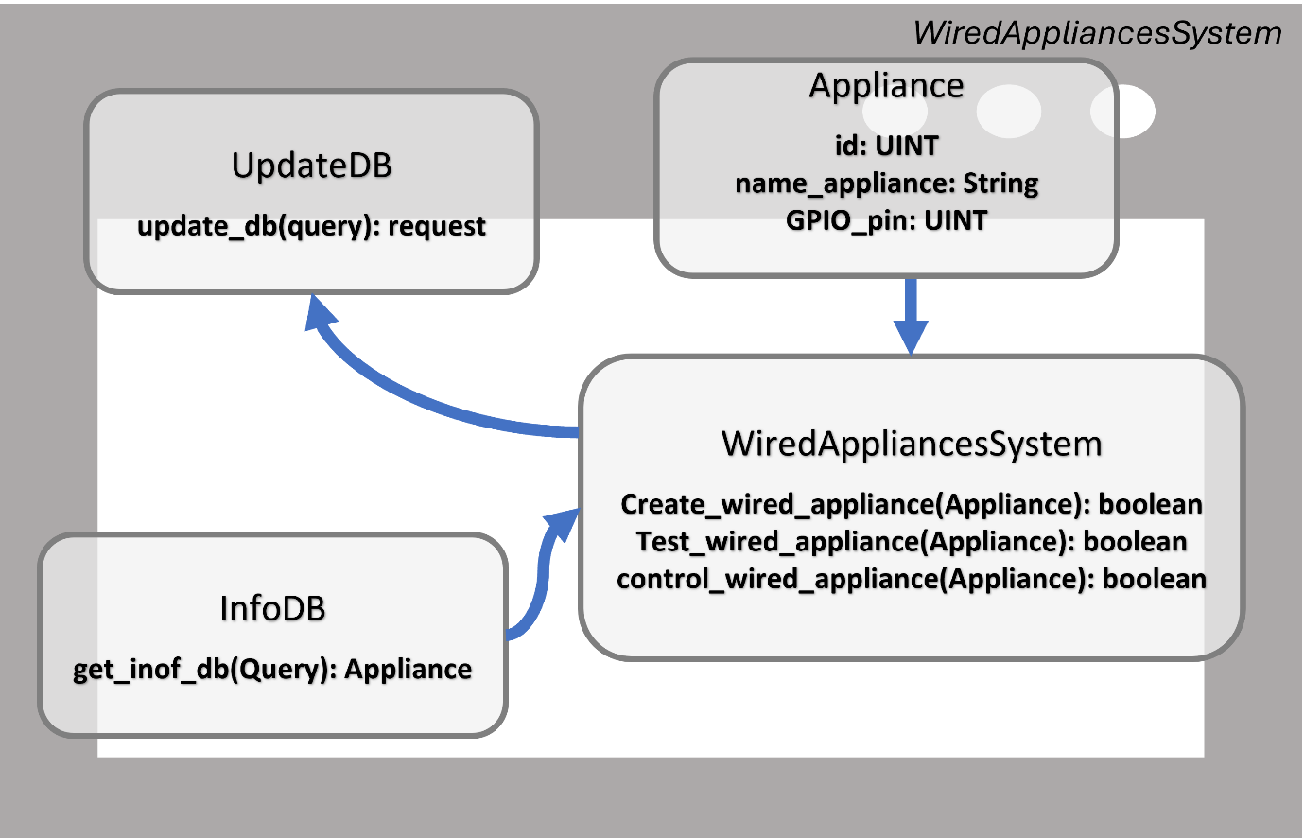
03
Back-end
Wired appliances control – Class Diagram

Slide 26
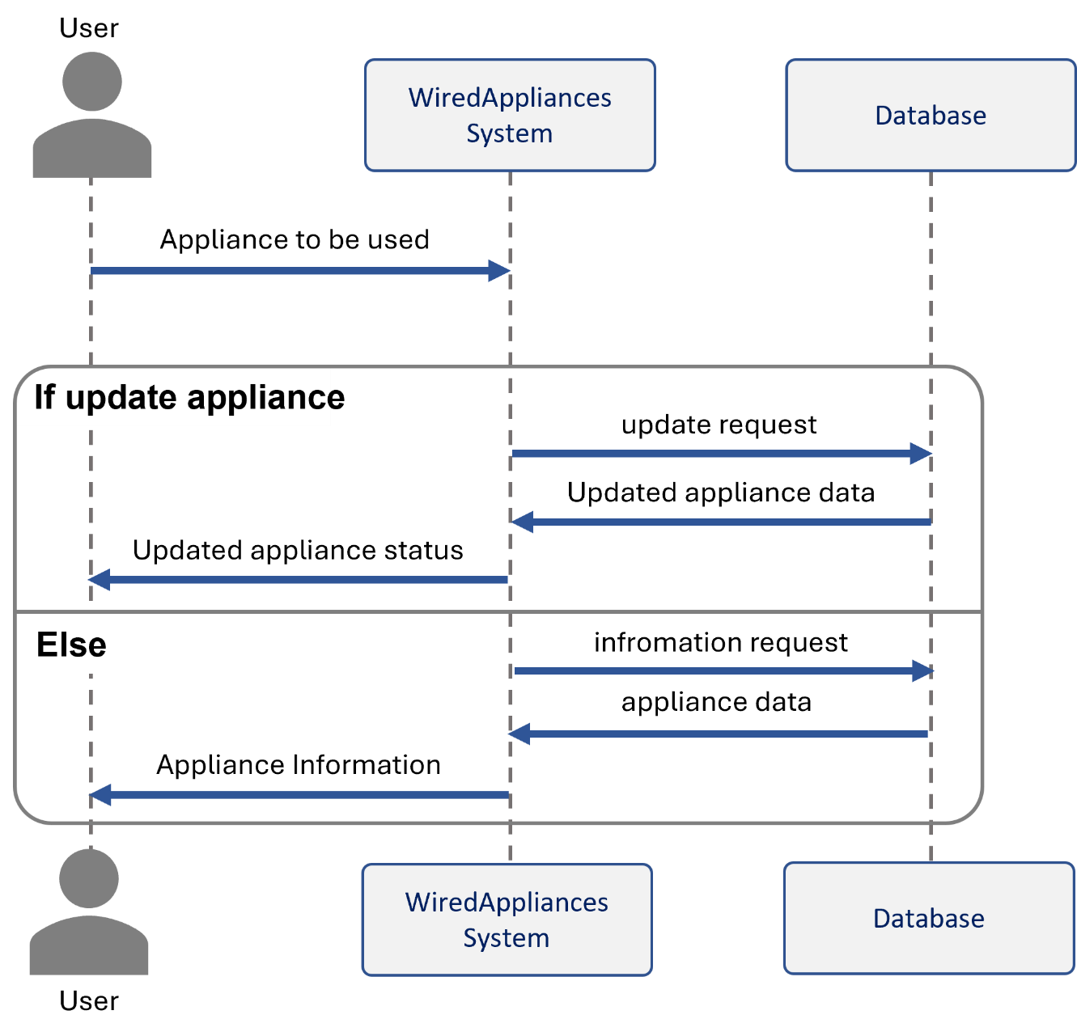
03
Back-end
Wired appliances control – Sequence Diagram

Slide 27
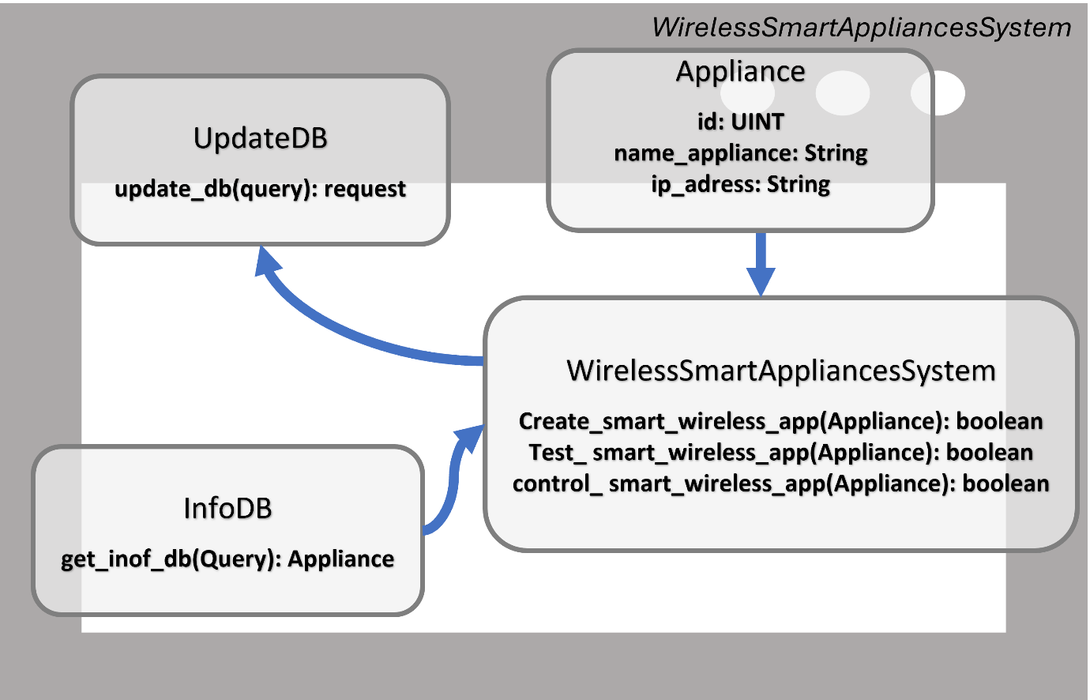
03
Back-end
Wireless smart appliances control – Class Diagram

Slide 28
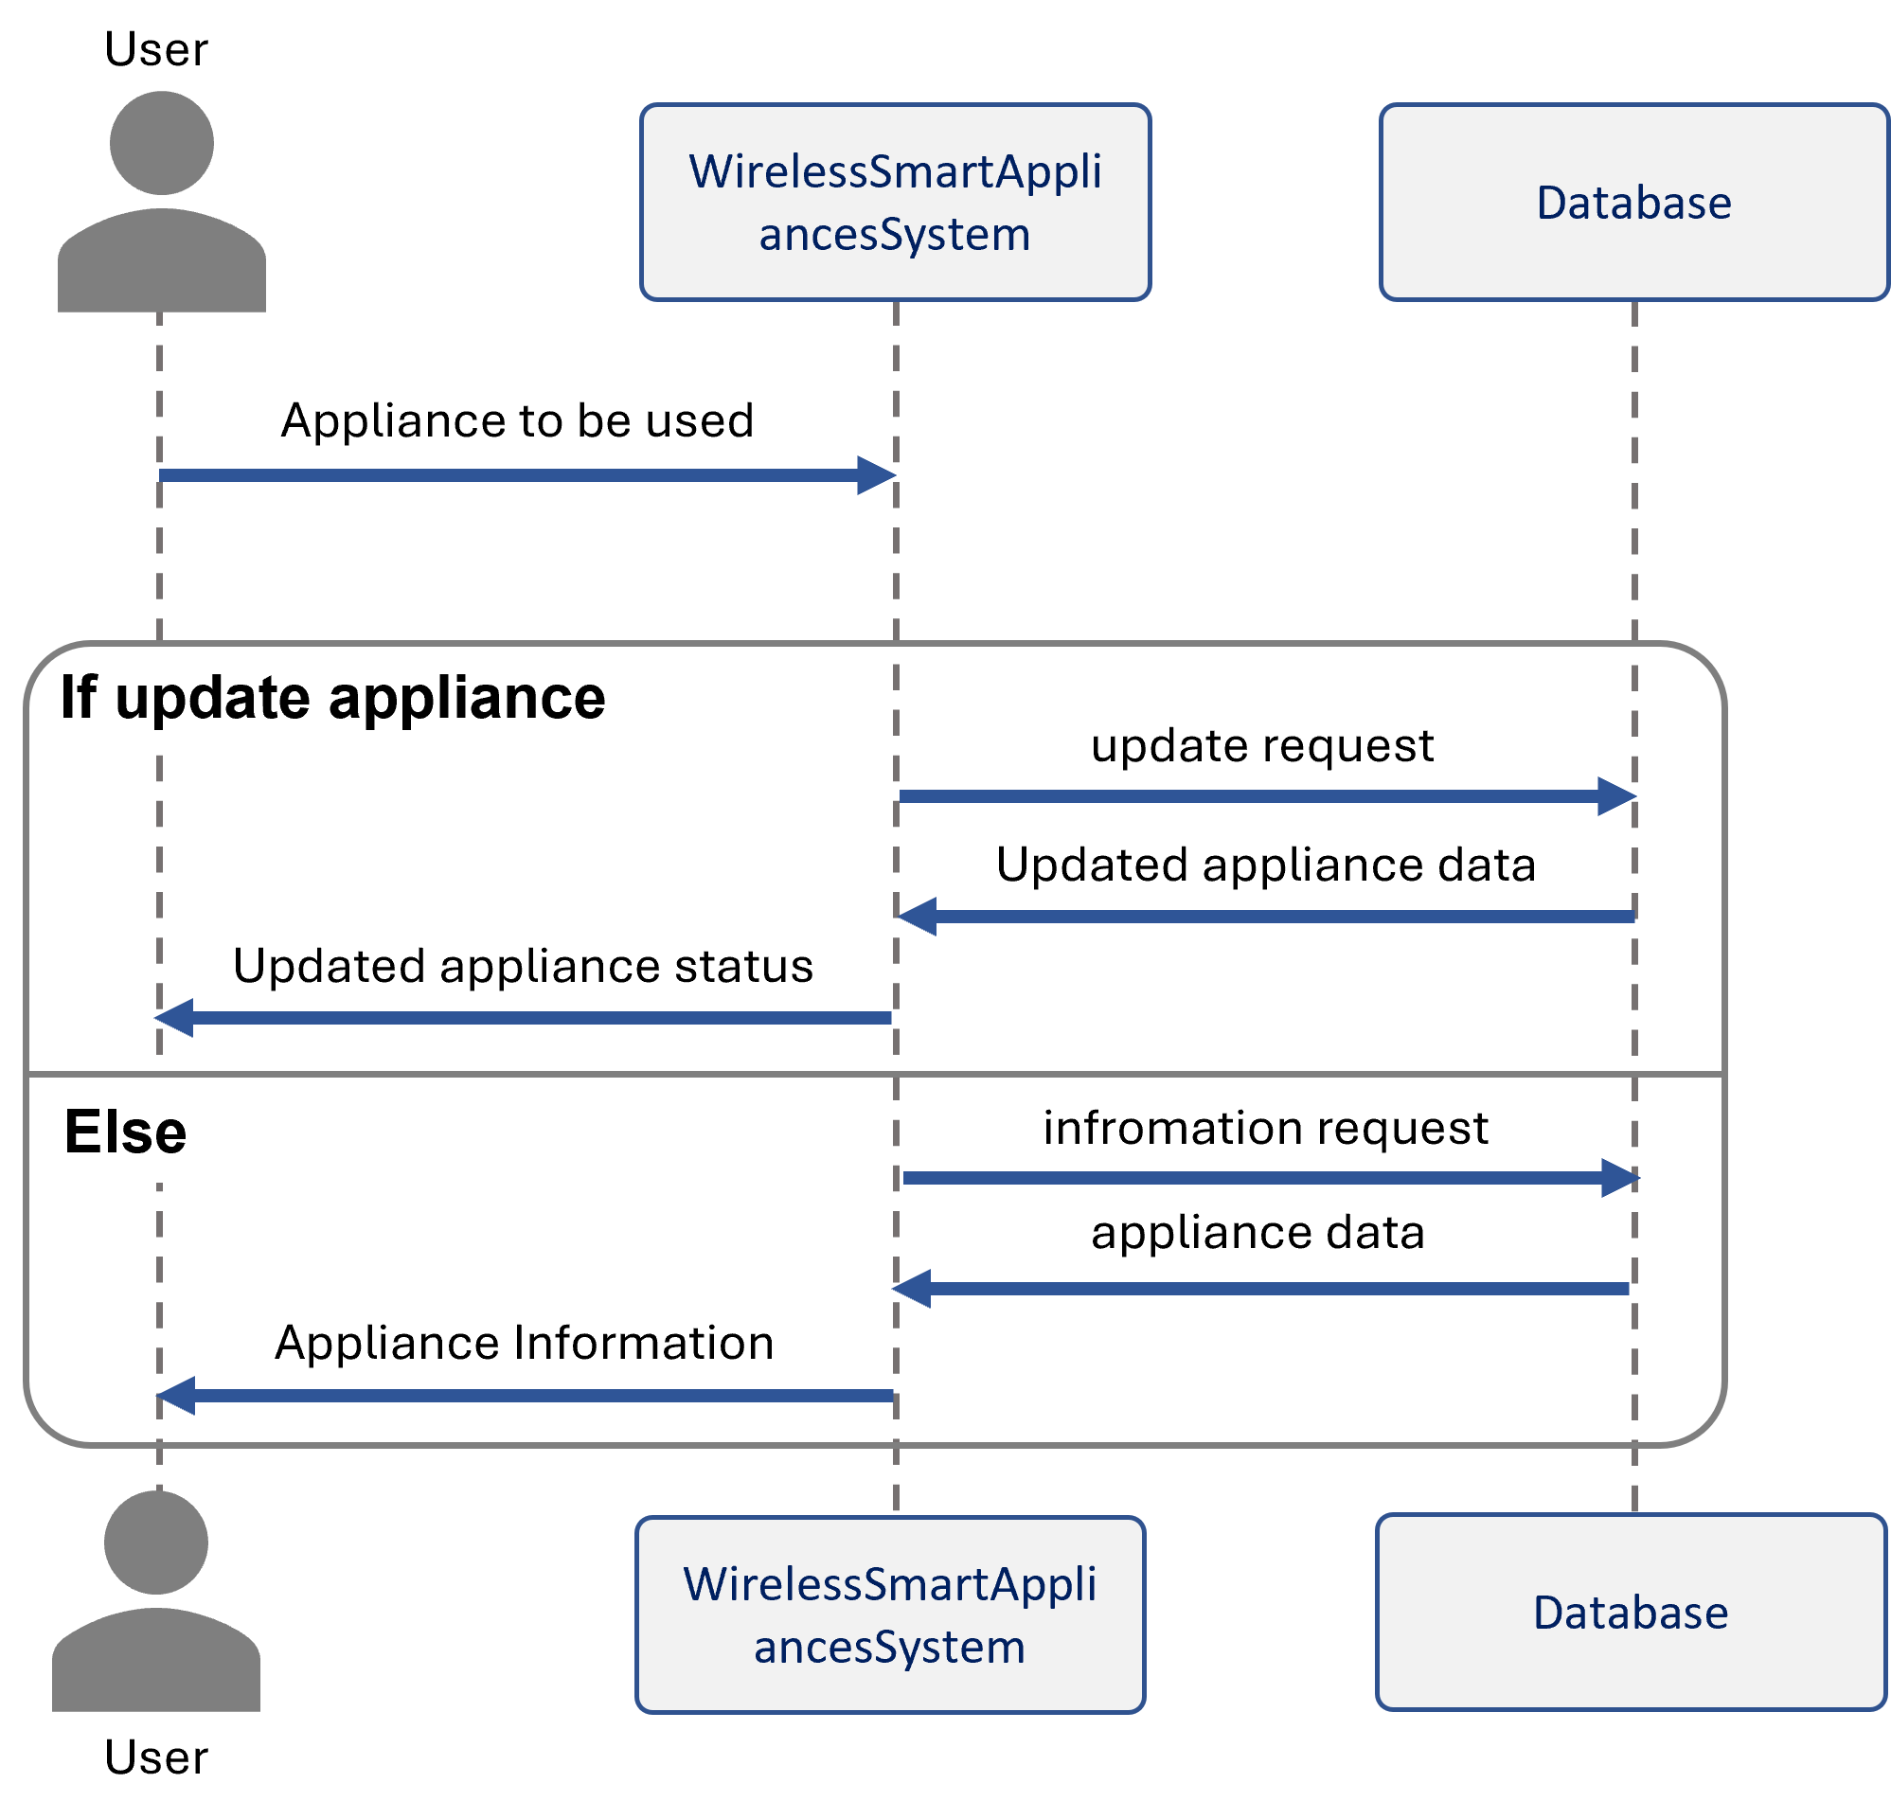
03
Back-end
Wireless smart appliances control – Sequence Diagram

Slide 29
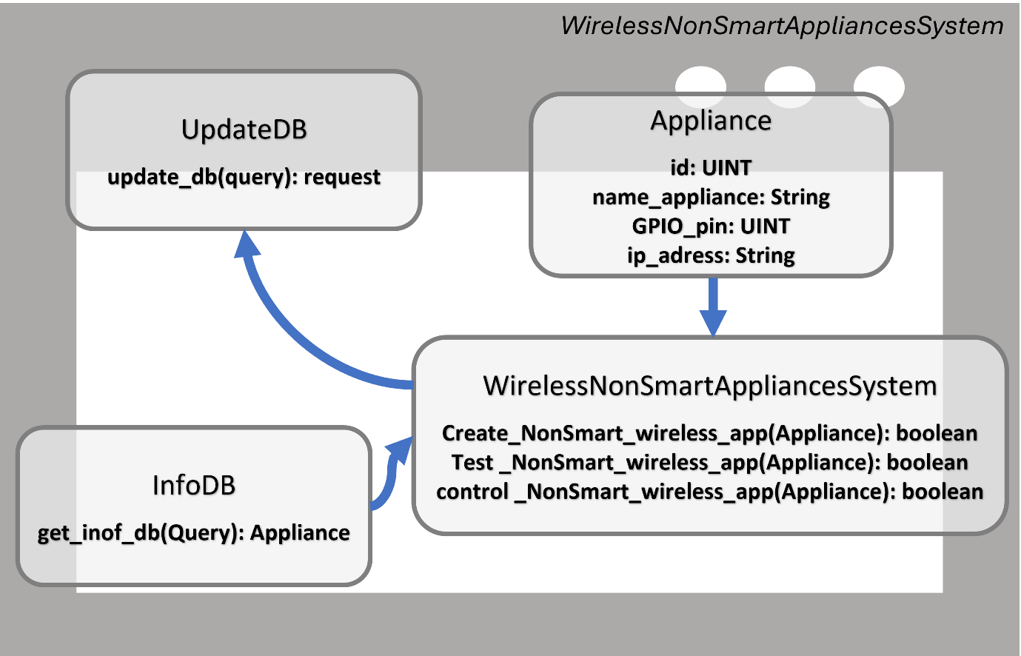
03
Back-end
Wireless non-smart appliances control – Class Diagram

Slide 30
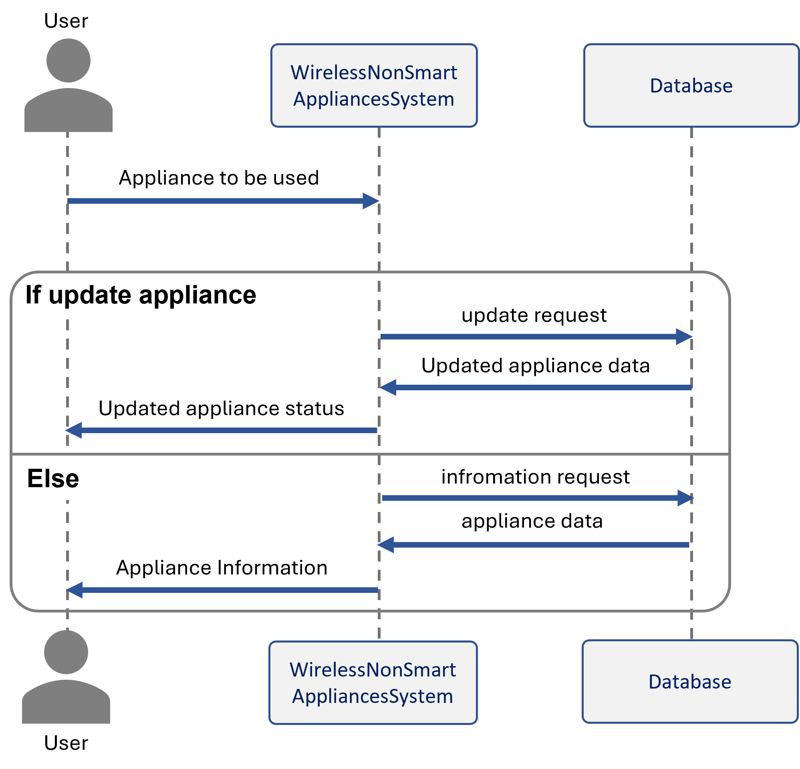
03
Back-end
Wireless non-smart appliances control – Sequence Diagram

Slide 31
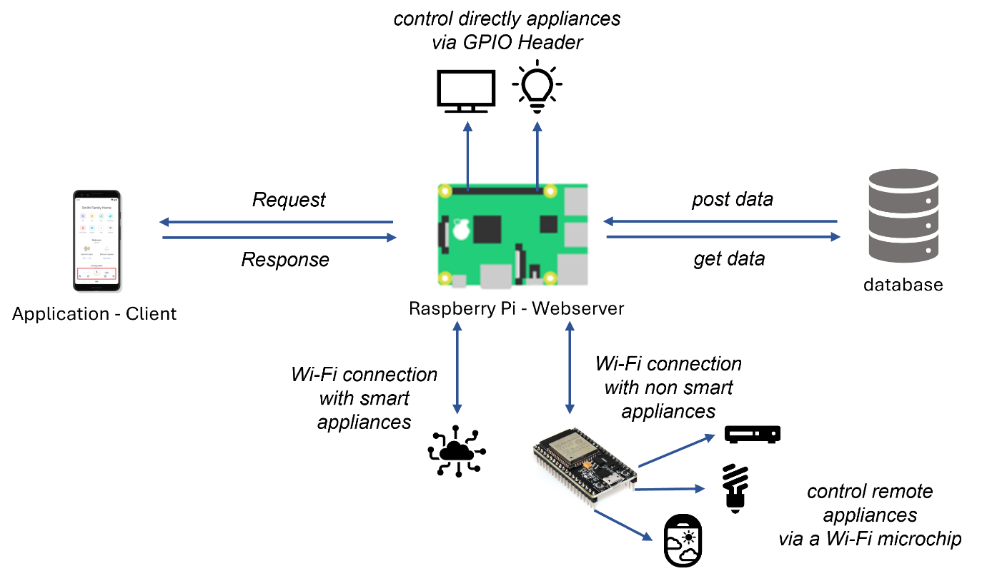
03
Back-end
Summary

Slide 32
1
User
PART 5
Database
2
Appliance
3
Macro

Slide 33
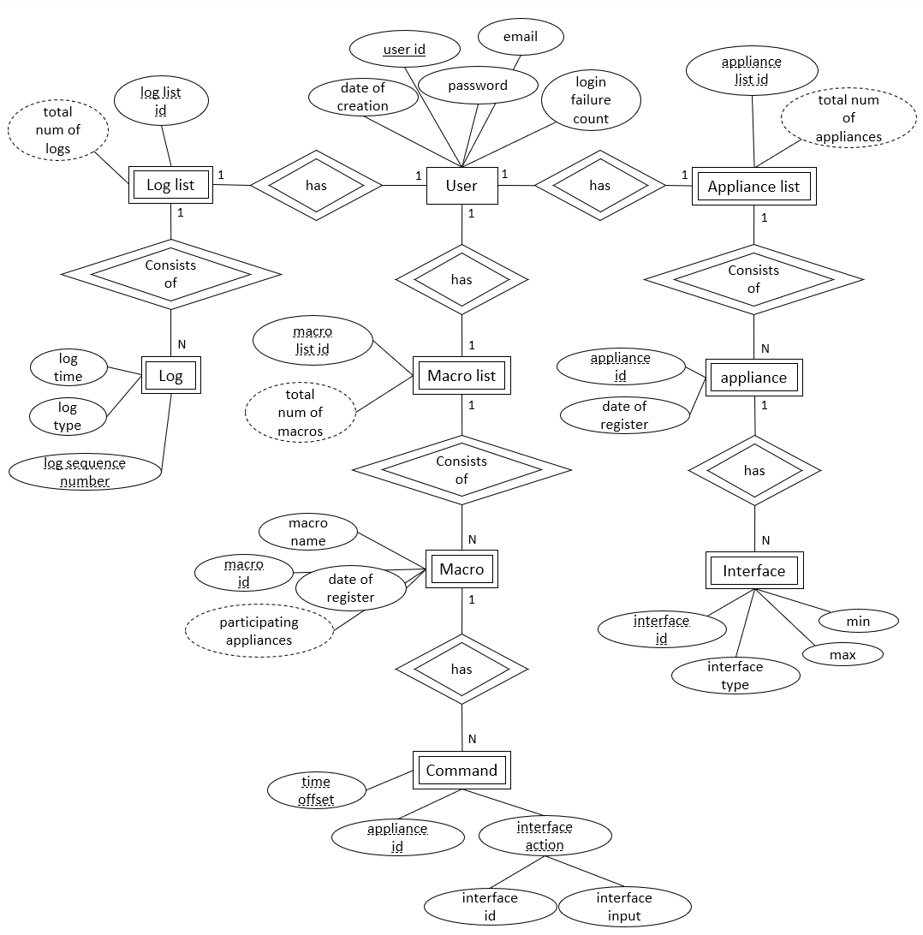
04
Database
Overview

Slide 34
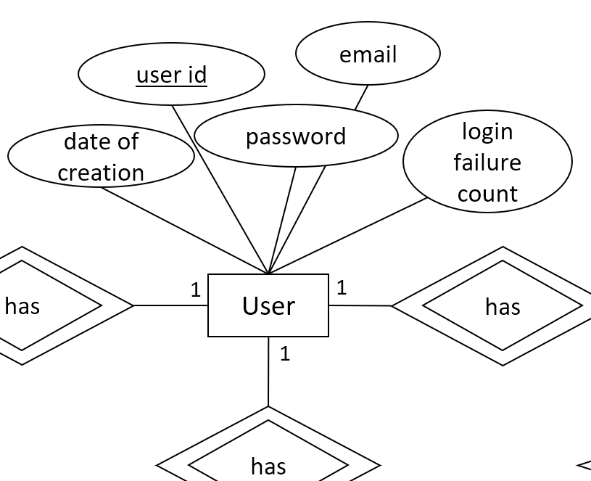
04
Database
User

Slide 35
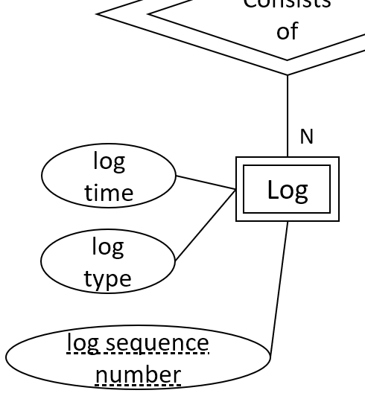
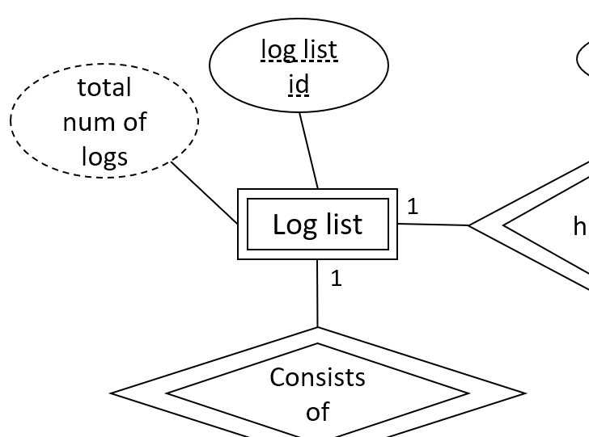
04
Database
Log & Loglist

Slide 36
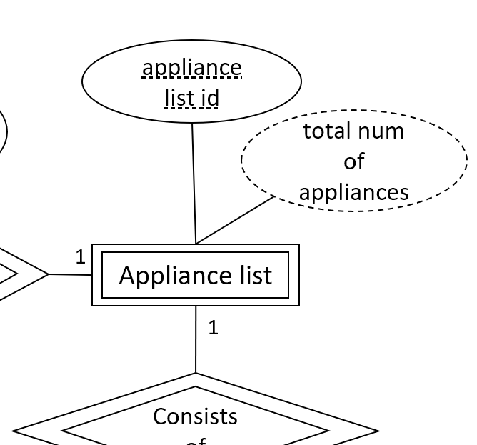
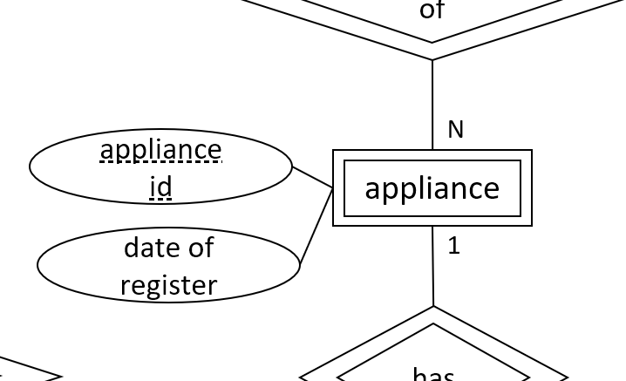
04
Database
Appliance & Appliance list

Slide 37
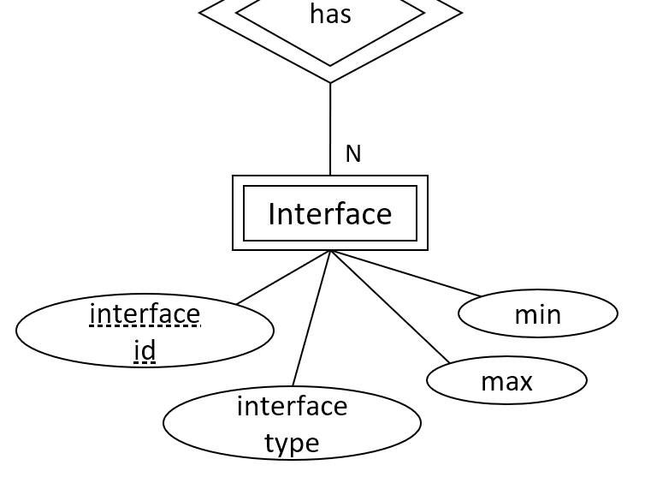
04
Database
Interface

Slide 38
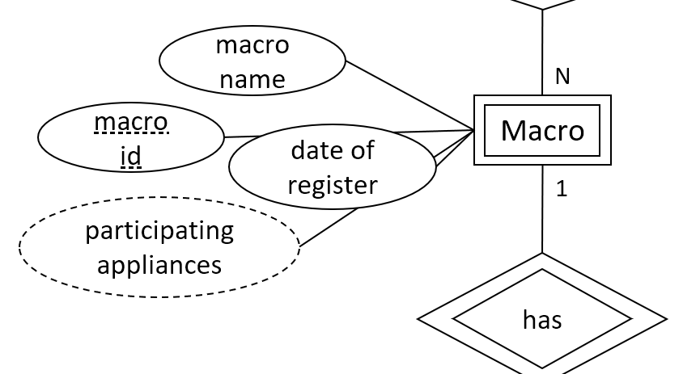
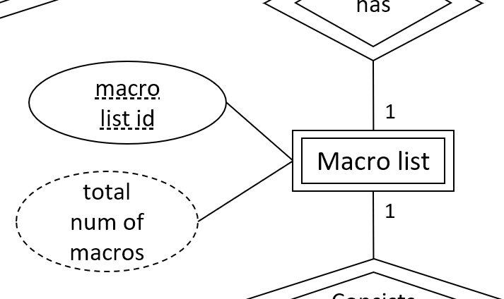
04
Database
Macro & Macro List

Slide 39
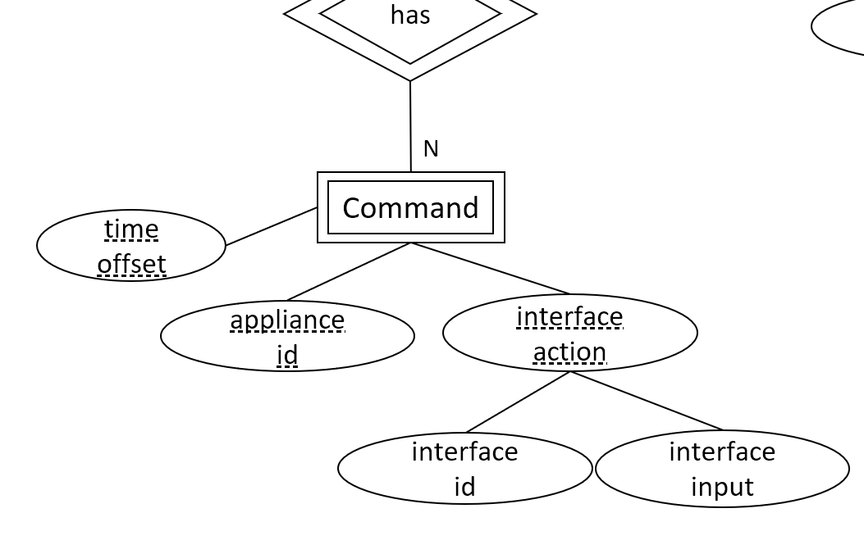
04
Database
Command

Slide 40
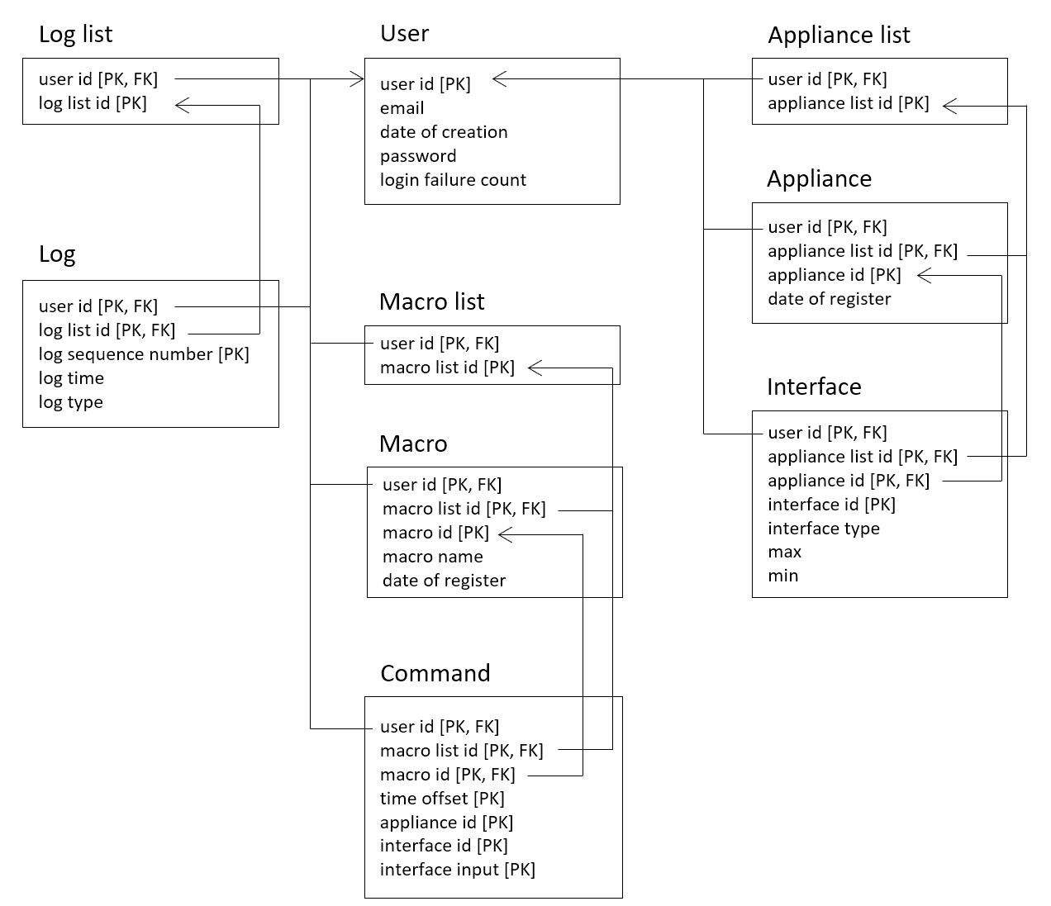
04
Database
Summary

Slide 41
Thank you
Team 12

